Slide 1

X-MES

Slide 2
Menu LIST
1.BB8 (SFIS data query)
2.Windows Application Access
3.Windows Application Reset password
4.Uop status Maintain
5.Time control Maintain
6.SDS control Maintain
7.Auto Report MAILID Maintain

Slide 3
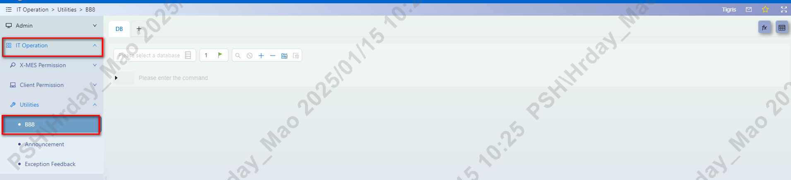
BB8 (SFIS data query)
IT Operation ➔Utilities➔BB8

Slide 4
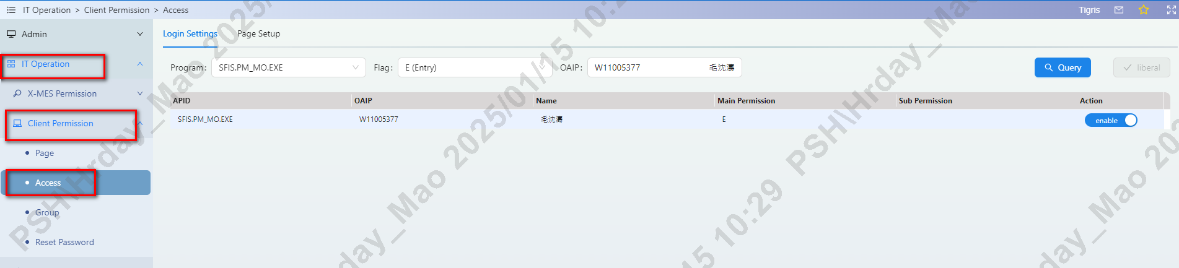
Windows Application Access
IT Operation➔Client Permission➔Access

Slide 5
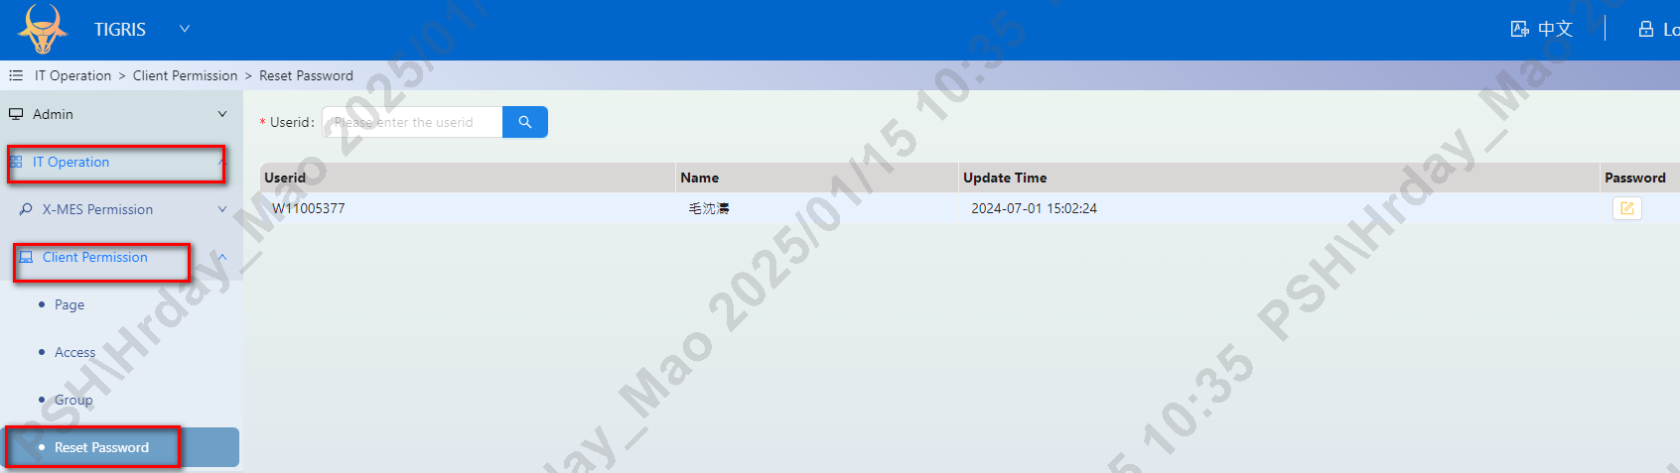
Windows Application Reset password
IT Operation➔Client Permission➔Reset Password

Slide 6
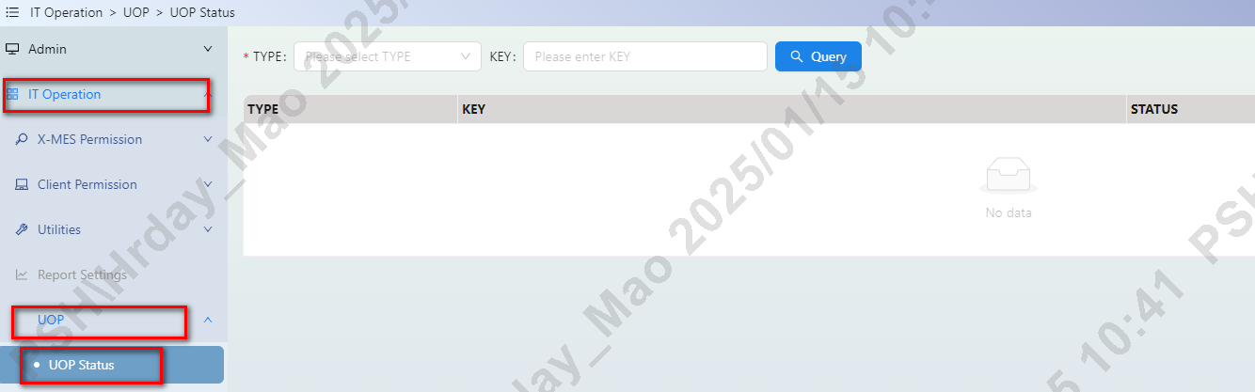
Uop status Maintain
IT Operation➔UOP➔UOP Status

Slide 7
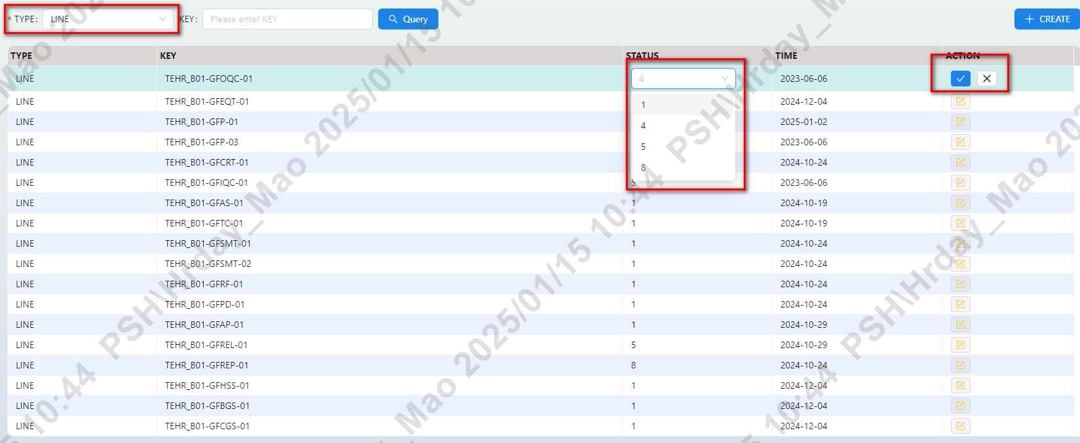
Uop status Maintain
1.Select TYPE LINE
2.QUERY(Do not enter information to query all, enter information to query a single transaction)
3.ACTION (Modify status)
4.Select the required status
5.Save or cancel

Slide 8
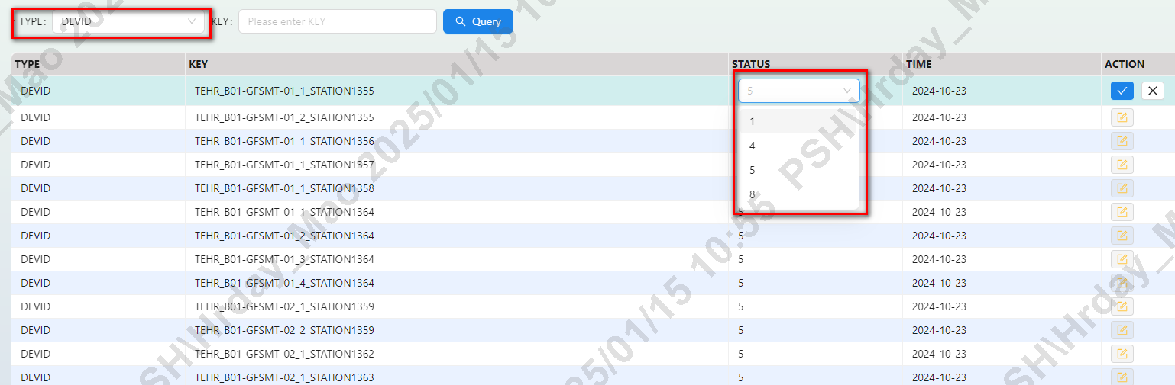
Uop status Maintain
1.Select TYPE DEVID
2.QUERY(Do not enter information to query all, enter information to query a single transaction)
3.ACTION (Modify status)
4.Select the required status
5.Save or cancel

Slide 9
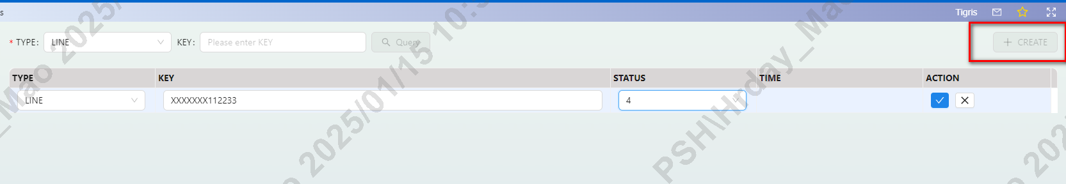
Uop status Maintain
1.CREATE(new line or new DEVID)
2.Select TYPE (LINE or DEVID)
3.KEY (input detail line or devid)
4.Select status
5.Save or cancel

Slide 10
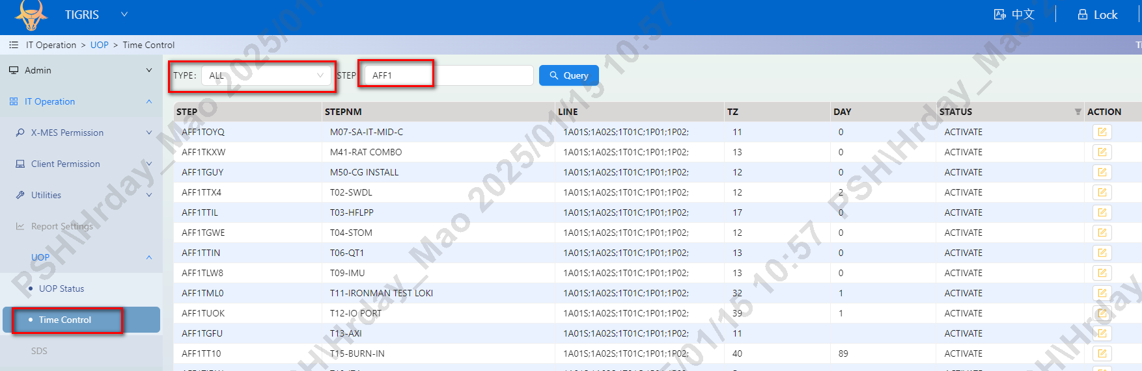
Time control Maintain
IT Operation➔UOP➔Time Control

Slide 11
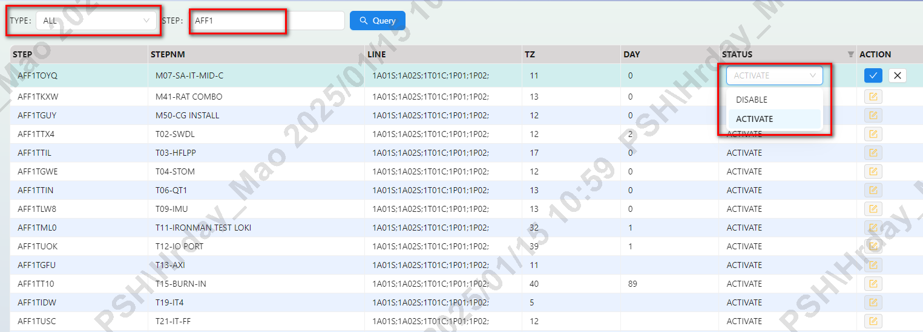
Time control Maintain
1.Select TYPE ALL, step input ROUTE
2.QUERY
3.ACTION (Modify status disable or active)
4.Save or cancel

Slide 12
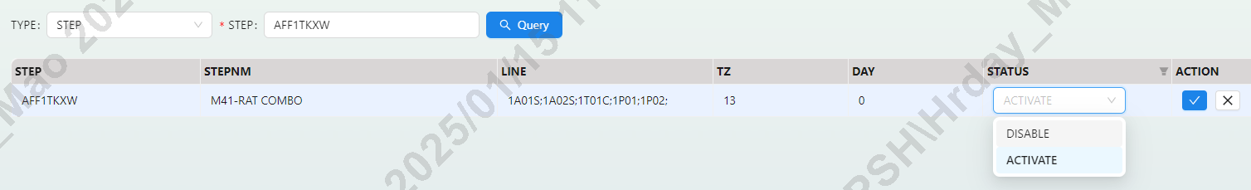
Time control Maintain
1.Select TYPE step, STEP input detail step
2.QUERY
3.ACTION (Modify status disable or active)
4.Save or cancel

Slide 13
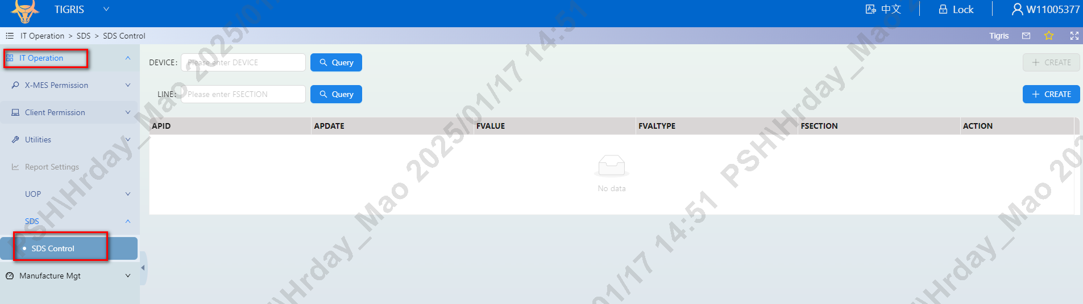
SDS control Maintain
IT Operation➔SDS➔SDS CONTROL

Slide 14
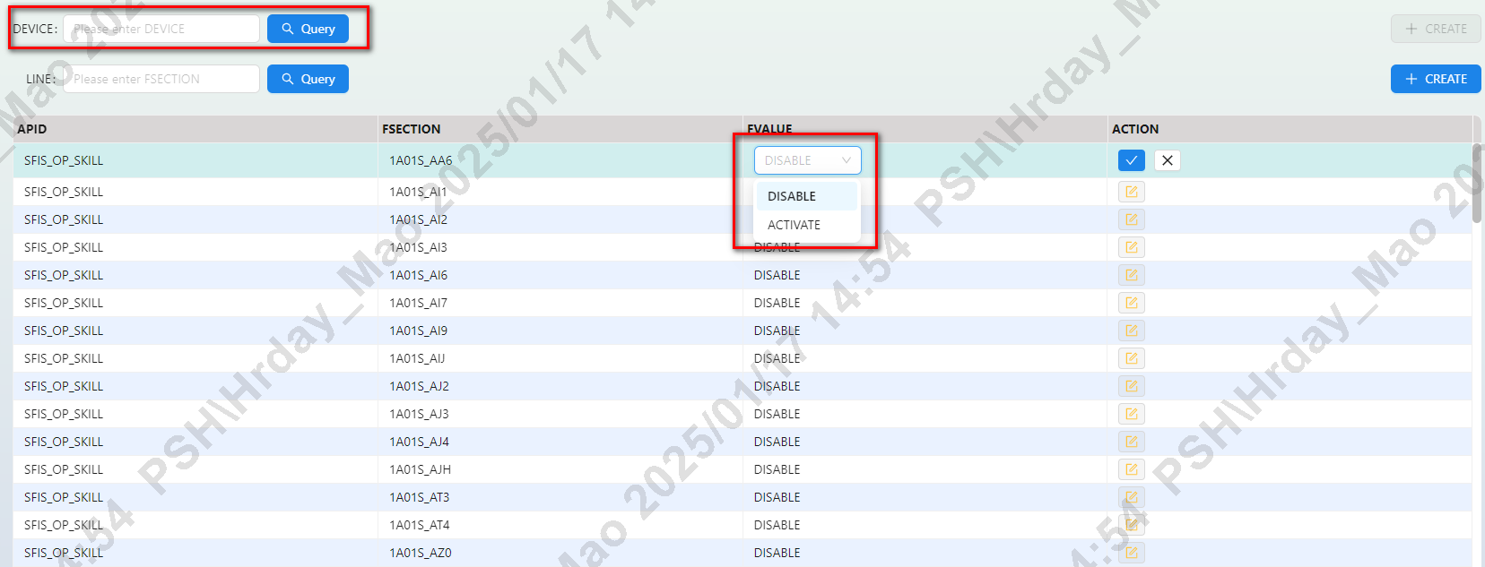
SDS control Maintain
DEVICE FUNCTION:
1.DEVICE QUERY can search all SDS GRP and LINE status
2.If you want change ,use action and can change the status (disabled or activate)

Slide 15
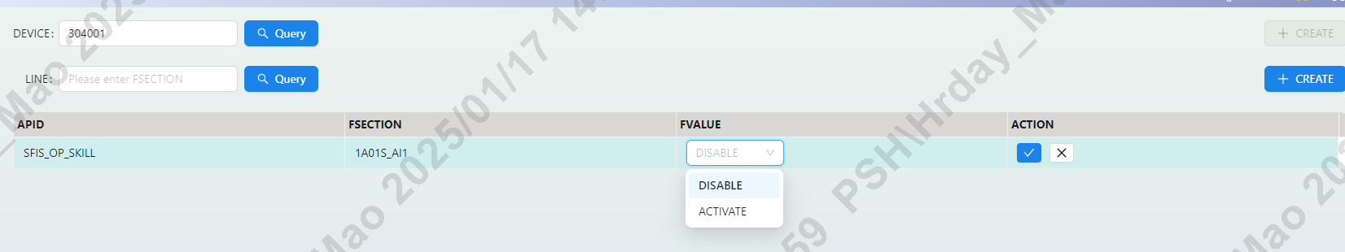
SDS control Maintain
1. A single DEVICE input can query the status of corresponding LINE and GRP
2.If you want change ,use action and can change the status (disabled or activate)

Slide 16
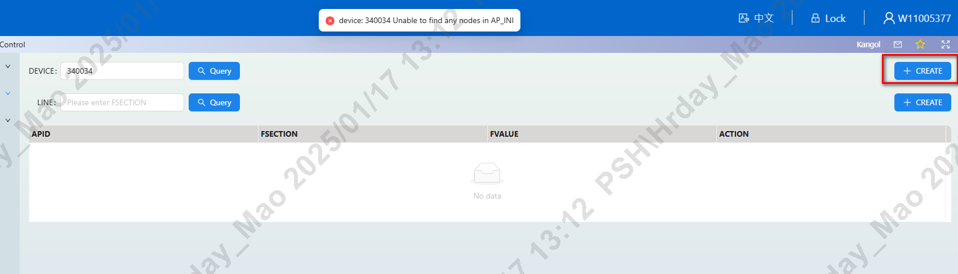
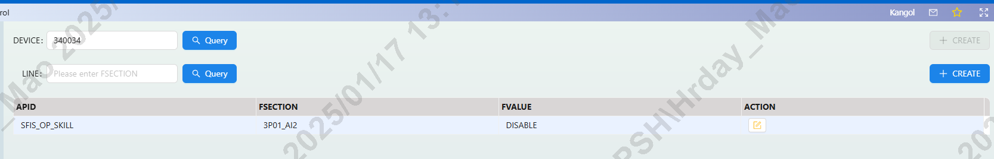
SDS control Maintain
1. If the entered DEVICE does not exist, it means that SDS control is not enabled on this station.
2. If you want to set up controls for this station, you can click CREATE
3. This will generate a new control. The default state is deactivated. If necessary, the control can be turned on manually.

Slide 17
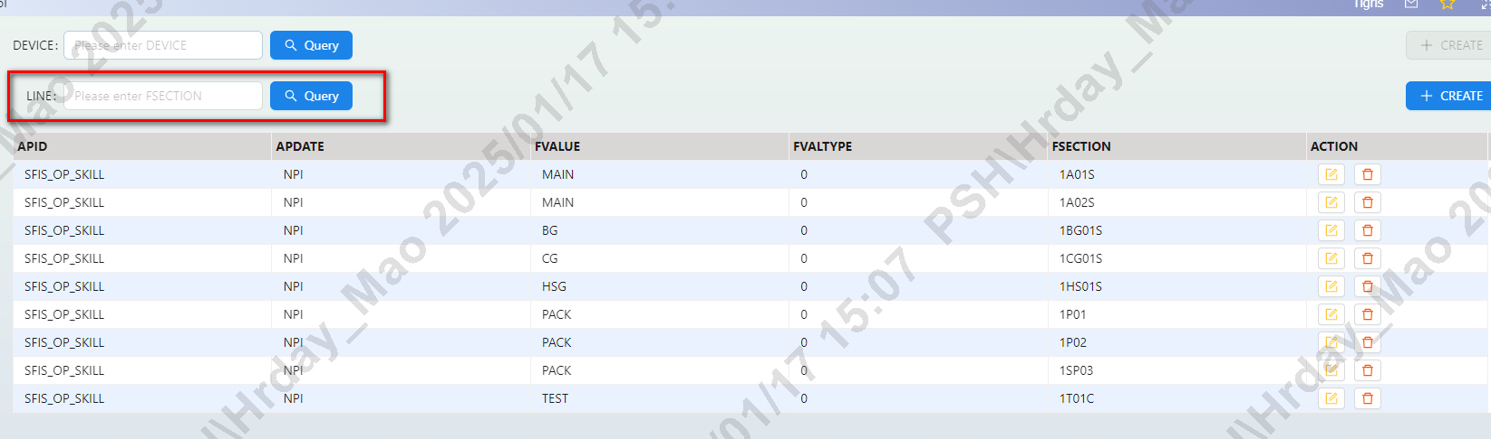
SDS control Maintain
LINE FUNCTION:
1.LINE QUERY can search all LINE status, If LINE exists, it means that the SDS control of this LINE is enabled.
2. If you want to disable SDS control of this LINE, you can delete it.
NOTE:LINE has two modes: MP and NPI(Need to match the SDS system)
If use MP, FVALTYPE must set 0
If use NPI,FVALTYPE =0(NO NEED TO CHECK NPI LEVEL)
If use NPI,FVALTYPE =1(CHECK NPI LEVEL )

Slide 18
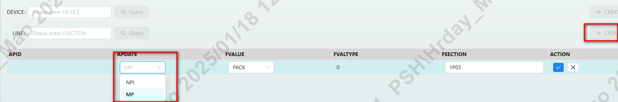
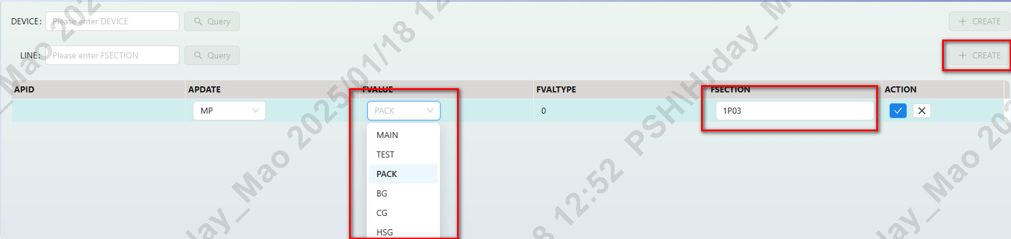
SDS control Maintain
LINE FUNCTION:
If you want to start a LINE, you need to create it
Need choose APDATE,FVALUE,FVALTYPE,FSECTION

